Slide 1



Live Sentiment for
ChatGPT, Claude and Gemini
AI FOR GOOD MINOR | WEEK 6 HACKATHON
A dashboard that shows how people react to AI assistants,
while it happens.
Jalie Vermeegen & Minhyeok Sung
Notes:
Hi, we are Jalie and Minhyeok. Our project is a live dashboard that tracks how people talk about ChatGPT, Claude and Gemini online, and whether those reactions are positive, neutral or negative.

Slide 2
The problem
AI assistants change every few weeks. What people think of those changes is spread over thousands of posts, comments and reviews.
Too much to read
It moves fast
Easy to miss
Checking several platforms by hand takes too long once the posts start piling up.
An announcement or one viral post can change the conversation within hours.
A real complaint gets buried between memes, jokes and general opinions about AI.
Source: IBM, “What is sentiment analysis?”
2
Notes:
Companies like OpenAI, Anthropic and Google update their assistants all the time. People react to that online, but those reactions are scattered everywhere. Reading all of it by hand doesn't work once the volume grows, and things change within hours. That's the gap we looked at.

Slide 3
Our user and his decision
Meet Elon (fictional)
Product analyst on the ChatGPT team at OpenAI. He follows what people say about ChatGPT, and about Claude and Gemini to compare.
HIS DECISION
Which recurring issues should go to the product or communications team, and does it need attention today or can it wait for a later report?
The same goes for analysts at Anthropic and Google.
Example: lots of posts worried about privacy → Elon asks the comms team to check if their explanations are clear enough.
3
Notes:
Our user is Elon, a made-up analyst on the ChatGPT team. His job is to keep an eye on public reactions. The decision the dashboard helps with: which issues keep coming back and should be passed on to the product or comms team, and how urgent that is.

Slide 4

SDG 9: Industry, Innovation and Infrastructure
Target 9.5: encourage innovation and improve technological capabilities.
LLM companies release another update or a new trend pops up
People use it and post about it
Our dashboard turns the posts into signals
The team checks it and improves the product
It really happens
Cheap to reuse
To be honest
OpenAI rolled back a GPT-4o update after lots of negative feedback.
Runs locally, no paid API or subscription, so smaller teams can use it for their own products.
Our part is indirect. We help evaluate innovations, we don't prove they get better.
Source: OpenAI, “Sycophancy in GPT-4o: what happened”
4
Notes:
Innovation is a cycle: release, people use it, they react, and that feedback should go back into the next version. For AI assistants this cycle is really fast. Our dashboard helps with the step where public reactions become something a team can act on. The GPT-4o rollback shows this actually happens. We're honest that our contribution is indirect.

Slide 5
What we built
1
2
3
4
5
Fetch
Filter
Label
Store
Show
Bluesky, Hacker News and App Store reviews, every 5 minutes
Keyword rules sort posts per assistant. Posts naming more than one go to “Comparisons”
The transformer says positive, neutral or negative
Everything goes into SQLite, no duplicate posts
Streamlit dashboard, refreshes about every 15 seconds
The model we used:
cardiffnlp/twitter-xlm-roberta-base-sentiment
Trained on about 198 million tweets, works in 8 languages. Good fit for short, sassy Bluesky posts.
5
Notes:
Our Python collector grabs new posts every five minutes, sorts them per assistant, lets the transformer label them, and saves everything in a SQLite database. The Streamlit dashboard reads from that database. We picked this model because it was trained on tweets, and Bluesky posts look a lot like tweets.

Slide 6
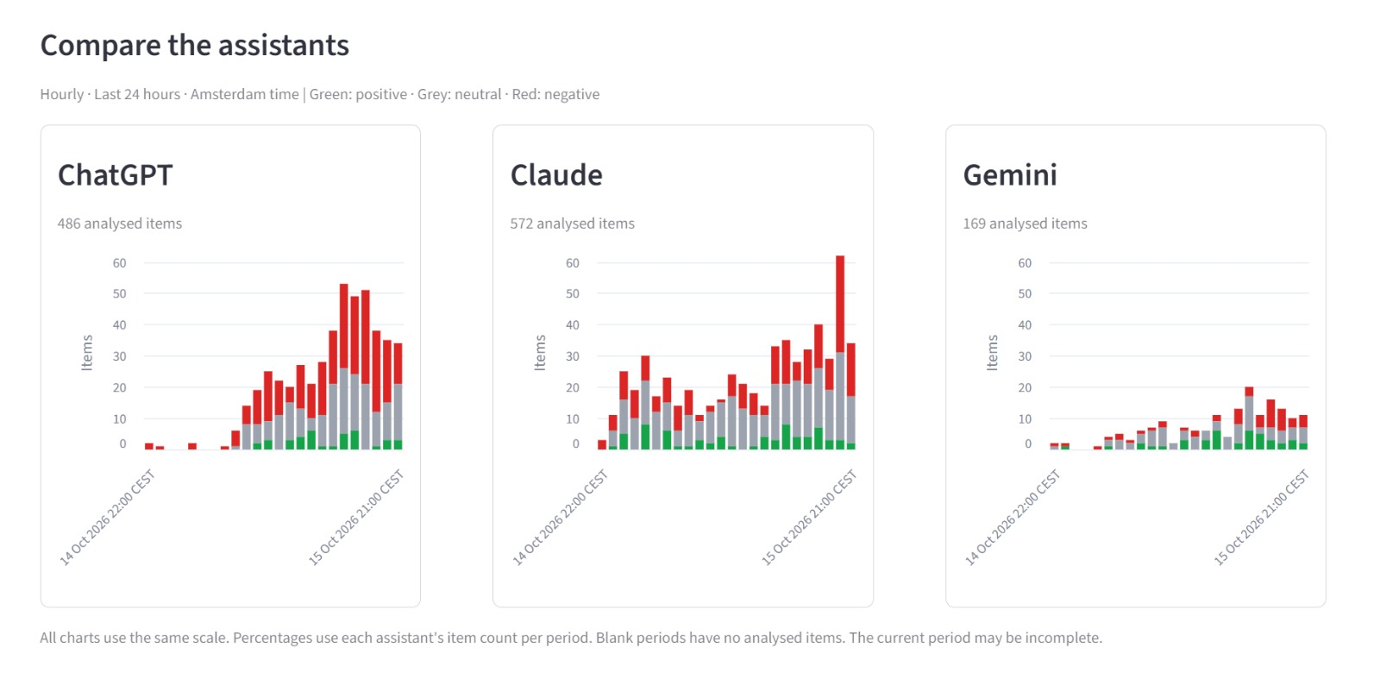



The live chart
How to read it
Positive
Neutral
Negative
Group by hour or by day
Switch between counts and percentages
Times in Amsterdam time
6
Notes:
This is the main view. Each assistant gets its own chart: green is positive, grey neutral, red negative. You can group per hour or per day, and switch to counts so you can see if a big percentage is based on only a few posts.

Slide 7
Why did the model say that?
Common words
Sentiment filter
One post at a time
Integrated Gradients (Captum) finds up to 5 words per post that pushed the label. We count them in a positive and a negative list.
The VADER word list picks out the clearly positive or negative words from those lists.
Pick a post and see the words that support the label in blue and the ones that go against it in orange.
Why it helps Elon: if a word like “suing” suddenly shows up a lot, that could point to how to address the media and look into changes to prevent more lawsuits from happening.
These are estimates, not proof that a label is right.
8
Notes:
We added three ways to look inside the predictions. They show which words made the model go positive or negative. It's an estimate, but it helps the analyst spot new topics quickly, like a sudden rise in the word "suing".

Slide 8
Testing: 74 posts we labelled ourselves
30 negative, 26 neutral, 18 positive. Then we checked how often each method agreed with us.
Method | Matched us | Agreement | Negative (30) | Neutral (26) | Positive (18)
XLM-RoBERTa (ours) | 52/74 | 70.3% | 23 | 17 | 12
DistilBERT | 39/74 | 52.7% | 18 | 13 | 8
Word-list baseline | 31/74 | 41.9% | 3 | 22 | 6
RoBERTa won in every category, but still disagreed with us 22 times.
The baseline looks good on neutral only because it said “neutral” for 59 of the 74 posts.
9
Notes:
We labelled 74 posts from our own stream by hand and compared three methods. RoBERTa agreed with us 70 percent of the time, DistilBERT 53 percent, and a simple word-list baseline 42 percent. RoBERTa is also multilingual, which DistilBERT isn't, so we kept RoBERTa. But 22 disagreements is still a lot, which is why the posts always stay visible.

Slide 9
The failure that taught us the most
“There's your advertising slogan — ‘ChatGPT — Not quite as bad as heroin!’”
We said: Negative
RoBERTa said: Neutral
What went wrong
What we learned
It's obvious sarcasm. The model took “not quite as bad” at face value and missed the point.
6 of our 30 negative posts came out as neutral. Missed negatives hide complaints, so the analyst always has to read the posts before acting.
10
Notes:
This one stuck with us. Any person reads this as negative, but the model saw "not quite as bad" and went neutral. It's not a one-off: six of our thirty negative posts were labelled neutral. For Elon that's the dangerous mistake, because a complaint just disappears into grey. That's why we made the original posts one click away.

Slide 10
Limits and ethics
Who is missing
What the model misreads
Most data is from Bluesky: English-speaking, tech-savvy people who post. People who don't post or use other platforms aren't in it.
Sarcasm, slang and mixed opinions. A negative post that mentions ChatGPT isn't always about ChatGPT.
Real people's words
Source terms
Removing names doesn't make a post anonymous. It runs locally and we don't publish the data.
Apple's terms don't allow automated scraping, so the App Store source should be switched off without permission.
What we did about it: a separate Comparisons group, counts next to percentages, and the original posts always one click away.
11
Notes:
Our data is not everyone's opinion. It's mostly Bluesky, so one viral thread can dominate the chart. The model gets sarcasm wrong. We store real people's words, so we keep it local. And we found that Apple's terms don't allow this kind of scraping, so that source should be turned off. What we did: show counts, keep comparisons separate, and keep the posts readable.

Slide 11
Use the chart to find things. Read the posts to decide.
Thanks! Any questions?
Jalie Vermeegen & Minhyeok Sung · Demo video and code on our GitHub
Notes:
That's our main message: the chart tells Elon where to look, but the actual posts tell him what to do. Thanks for listening, happy to take questions.

